Slide 1
The unlikely case of libya
Hertie School of Governance “Trends of German Foreign Policy“ September 18, 2022

Slide 2
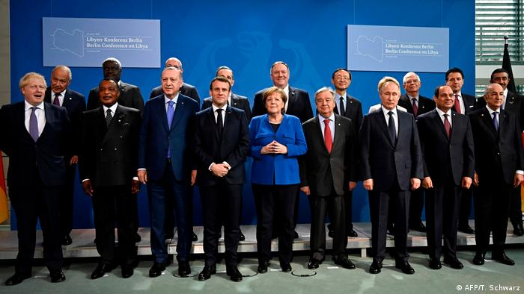
JANUARY 19, 2020
CHANCELLERY

Slide 3
QUICK RECAP I
2014
Elections to the HoR are declared
illegal by the Libyan Supreme Court.
Institutional split
HoR moves to Torbuk , also due to security concerns. East-West divide is established
2015
UN tries to broker a Government of National Accord (GNA), led by
Prime Minister Sarradj
Escalation spiral
HoR forms LNA led by General Haftar

Slide 4
QUICK RECAP II
2016-2019
LNA military campaign to capture Libya
Internationalization
LNA: France, Egypt, UAE, Russia GNA: Turkey, Italy, Qatar
Massive influx of mercenaries
2019
Battle of Tripoli
(3 out of 7 million citizens)
Diplomacy breaks down
Neither side has incentives to conclude a ceasefire

Slide 5
QUICK RECAP III
2019
Massive proliferation, arms embargo violations, heavy equipment enters the theatre
Equilibrium of Power
LNA fails to capture Tripoli, Russia brokers ceasefire
2020
Berlin Conference on Libya
Detenté
Commitment by all concerned
International actors to stop foreign interference

Slide 7
From civil war to proxy war

Slide 8
Russian federation
Russia backs the HoR and LNA, blocks their condemnation at the UNSC
Wagner fight alongside LNA, with support by heavy equipment (including air power)
Moscow confident that military decision will solve political gridlock (see: Syria)
Core interest:
→Securing oil and construction deals
(Libya: largest oil reserves and 4th largest gas reserves
in Africa)
Establishing a military footprint in the South Mediterranean

Slide 9
turkey
Turkey backs the GNA with Prime Minister Sarradj
Military base, 100+ military advisors, thousands of Syrian mercenaries: All at the request of the GNA government
”Savior of Sarradj”, including with drones and air defense systems
Core interest:
→Winning an episode in the battle for ideological supremacy
→ Expanding the control of energy reserves in the Eastern Mediterranean
→Establishing a military footprint

Slide 10
Qatar
Qatar backs the GNA with Prime Minister Sarradj
Significant financial support
Core interest:
→Winning an episode in the battle for ideological supremacy
→Competition with UAE and Saudi-Arabia

Slide 11
United arab emirates
UAE backs HoR and LNA
Significant financial support, massive influx of weapons, mercenaries and other resources
Core interest:
→Underlining its geopolitical ambition in the wider region
→ Winning an episode in the battle for ideological supremacy
→Competition with UAE and Saudi-Arabia

Slide 12
United states of america
USA has helped bring down Gaddafi, but lost attention quite quickly (which, unfortunately, led to many misunderstanding about what “Responsibility to Protect” means)
First, supports GNA politically, but not financially or military (except joint air strikes against IS and al-Qaida). Later, switches horses and supports LNA (although only politically)
Core interest:
Preventing Libya from becoming a safe haven for terrorism
→ Making sure that Russia doesn´t establish a vassal state

Slide 13
france
Spearheaded initial campaign against Gaddafi regime in March 2011
Supports GNA officially, but LNA und HoR unofficially
Core interest:
Securing lucrative contracts on all sorts of issues (reconstruction, oil and gas, military equipment)
Making sure that Libya doesn´t become a Muslim Brotherhood state
Another episode in the contest with Turkey

Slide 14
italy
Supports GNA und Prime Minister Sarradj - out of personal relationship with Conte, but also to stabilize UNSMIL
Core interest:
→Stabilizing Libya to the extent that it can prevent illegal migration routes
→ Making sure that the fallout of Libya´s proxy war doesn´t threaten Rome´s regional interests (including oil and gas contracts)

Slide 15
germany
Germany backs GNA, but not because of ideological conviction, but in support of the United Nations
Core interest:
→Stabilizing Libya to the extent that it can prevent illegal migration routes
Preventing Libya from becoming a safe haven for terrorism

Slide 16
Why Germany?
Soft power
Hard power
Economic power
Traditional ties

Slide 17
Reasons for leadership
Absence of U.S. leadership (+ lack of legitimacy)
European powers heavily invested with national interests
Perception as an honest broker:
No participation in ”No-Fly-Zone” operation in March 2011
No preferred side in terms of arms deals
Rather unsuspicious self-interest (migration flows)
Personal legitimacy of the Chancellor:
Her political capital has been the key
Growing sense of responsibility for its neighborhood

Slide 18
berlin Libya conference: Results I
”We reaffirm our strong commitment to the sovereignty, independence, territorial integrity and national unity of Libya. Only a Libyan-led and Libyan owned political process can end the conflict and bring lasting peace.”
→ Key pillars of liberal international rules-based order
“The Berlin Process (…) has the sole objective of assisting the United Nations in unifiying the International Community in their support for a peaceful solution to the Libyan crisis.
→ Foreign policy focused on empowering international organizations

Slide 19
berlin Libya conference: Results II
”There can be no military solution in Libya.”
Germans know this sentence ☺
”We commit to refraining from interference in the armed conflict or in the internal affairs of Libya and urge all international actors to do the same.”
→ That is what all this is about.

Slide 20
berlin Libya conference: Results III
”We call for a comprehensive process of demobilization and disarmament of armed groups and militias in Libya.”
Beginning of “sequencing” in three sectors: security, economic and financial reform, return to political process
”We express our full support to the operationalization of these conclusions by the Special Representative of the Secretary-General to Libya… We agree that the Berlin Conference on Libya is one important step in a broader Libyan-led and Libyan-owned process… We herewith create an International Follow-Up Committee (IFC), consisting of all countries and IOs that participated in today´s Berlin Conference on Libya {inlucinding four working groups}.”
→No one-time stunt, but part of the process

Slide 21
Negotiating an agreement
Usually, Heads of State and Government convene at the end of a process
Libya: Special case because of rigid front lines between the actors. Germany not only host, but mediator
Document is agreed by about 99% before conference on Advisor's level
Chairperson-style of the Chancellor: to the point, inclusive, leaving plenty of room for Bilats

Slide 22
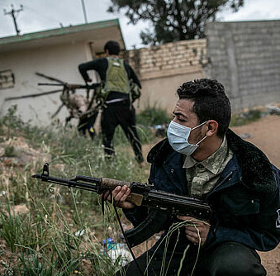
q&a
I am looking forward to any questions or comments that you may have.

