Slide 1
The sahel region and the illusion of distance
Hertie School of Governance “Trends of German Foreign Policy“ September 18, 2022

Slide 3
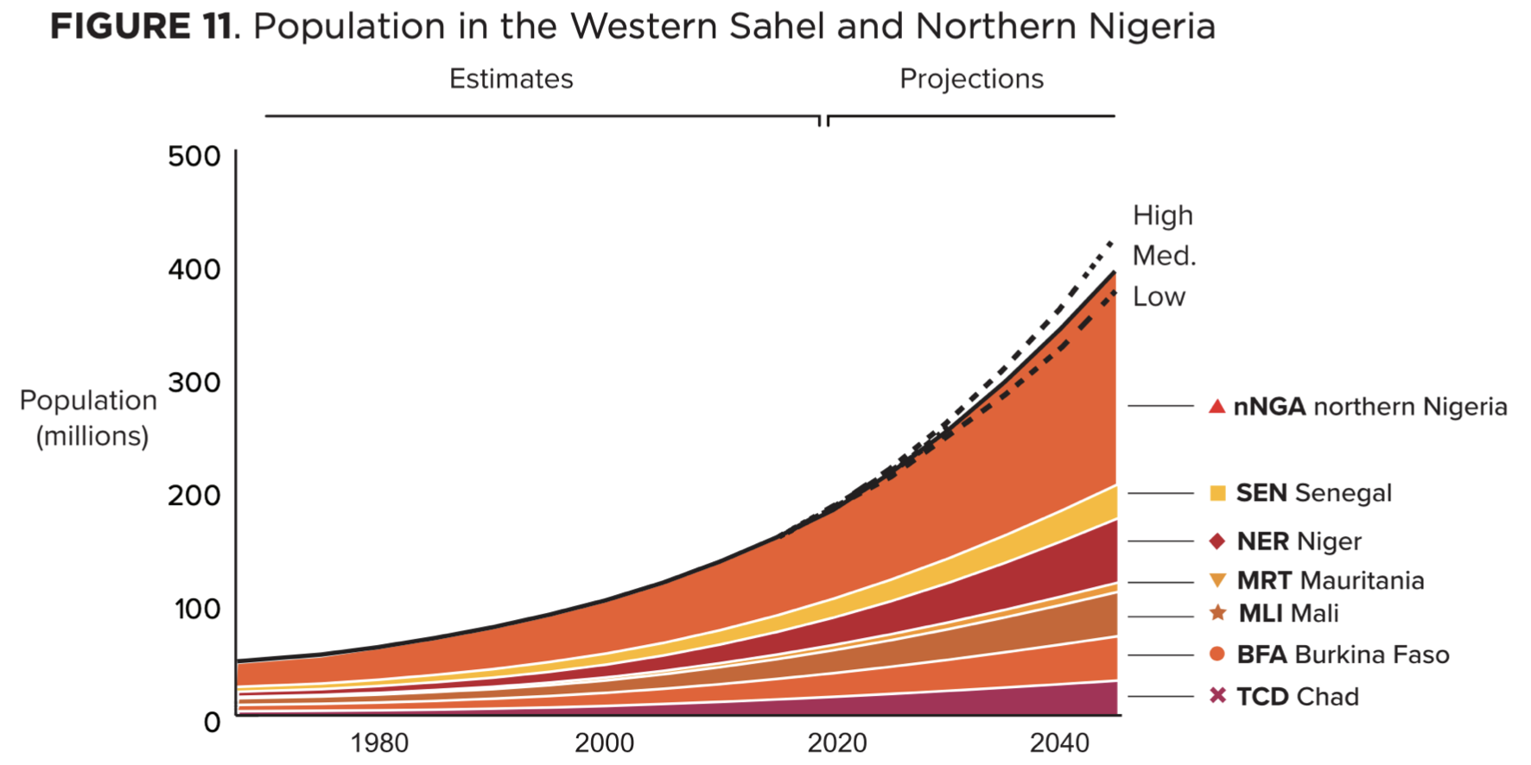
Population has increased five-fold in the past 60 years – from 21 million to 103 million.
Rather than yielding an economic dividend form its youthful population, state-run services are overwhelmed
Extensive urban slum conditions
Stall economic and social progress
Decreasing legitimacy of central government, vulnerability to the spread of fanatism and instability.

Slide 4
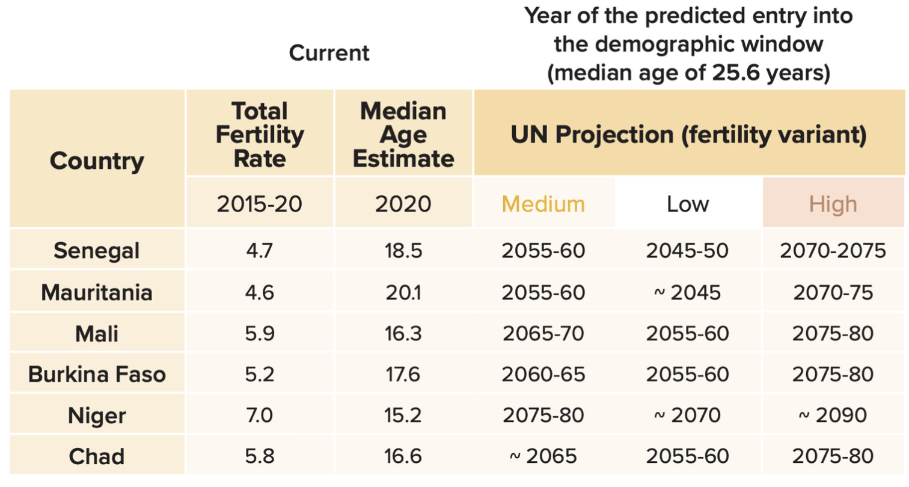
Age structure and the demographic window: None of the Western Sahelian countries are expected to reach that window within the next 20-to-25 years.
Demographic window: median age of around 25 or 26 years. The country general reach upper-middle levels of development (income, educational attainment, child survival)
Chad and Niger, just 1/5 of eligible girls are enrolled in secondary school.
Adolescent marriages are the region´s most serious deterrent to increasing girls´ educational attainment
Chad has the second highest maternal mortality rate

Slide 5
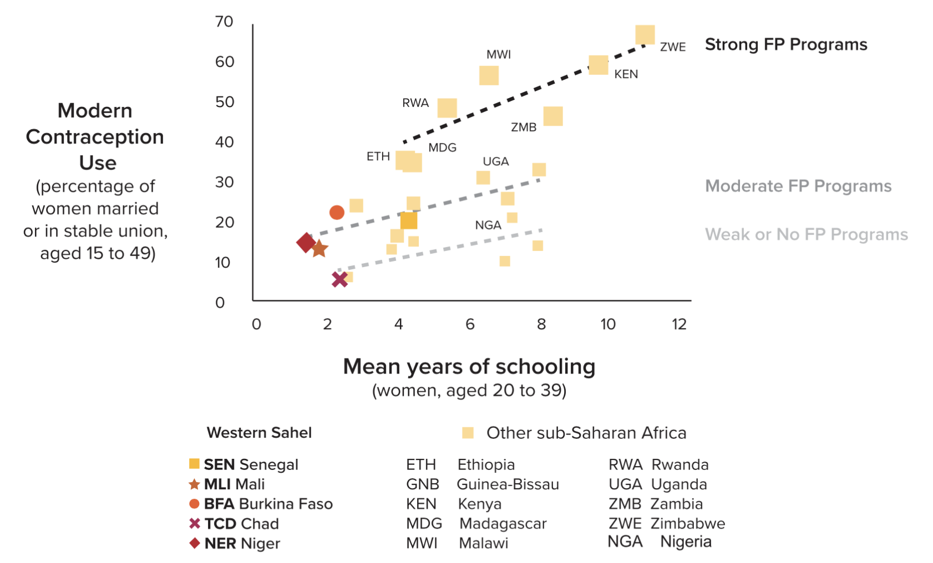

Slide 6
Urbanization: Urban population currently comprises 1/3 of region´s population. Projected to reach half by 2045
Rapid urban growth has outpassed massive investments in housing that have alleviated the situation in slum
Challenges: new housing, fresh water, energy, health, sanitation, security challenges
Hopes (especially of young men) rest on the urban job market

Slide 7
Between 1990 and 2015, more than 80% of migrant flows that originated in Sahelian countries ended beyond the region´s border: 60% Africa, 40% Europe and North America
These numbers exclude the dramatic rise of migration in the wake of escalation in the Lake Chad Basin, Niger, Burkina Faso and Niger in the ensuing years

Slide 8
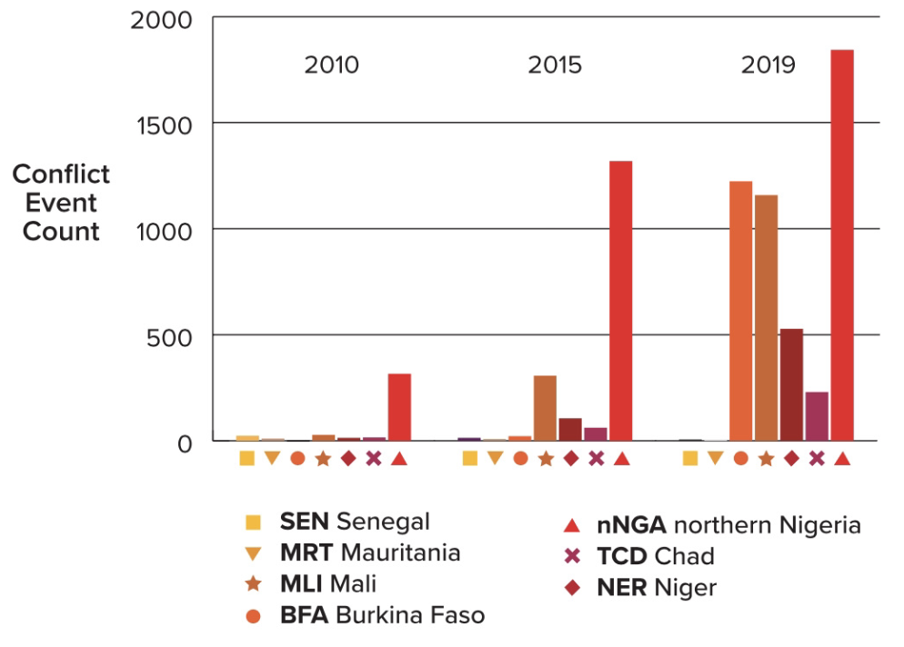
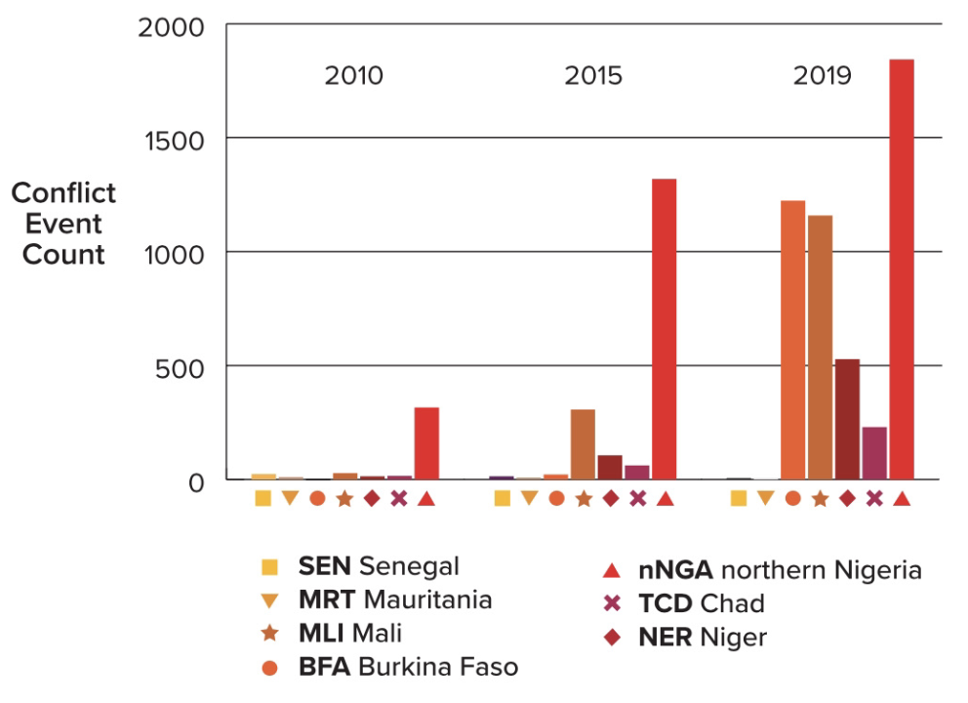
security
Rapidly growing insurgency across the region
Islamist insurgents restrict women´s access to education. Decline of autonomy and delivery of family planning services that could improve productive health and nutrition.
In 2020 alone, 6.500 people were killed in Mali, Burkina Faso and Niger
IDPs: 100.000 (2018) to 1.5 million (2020)

Slide 9
QUICK RECAP I
2012
Tuareg nomads return from Libya. Goal: Independence of breakaway state Azawad (Northern Mali)
Window of Opportunity
Islamist forces form loose coalition with Tuareg and capture large swaths of Mali
January 2013
French President Hollande launches Opération Sèrval (4.000 troops), including EU and US air support
Algiers accord
Decentralization of Northern Mali, investment program for Azawad

Slide 10
QUICK Recap ii
2015/2016
New unrest, instigated by Jihadists, sowing friction between ethnic groups (especially Dogon (non-nomadic) and Fulan (nomadic))
Decreasing Legitimacy
Government forces are unable to stop the violence; legitimacy decreases (ultimately led to the military coup in 2020 and 2021
2016 -
Intercommunal conflict in central Mali spills to Burkina Faso and Niger
Apex of Violence
January 2, 2021 Islamist kill over 100 civilians in Tillaberi, Niger, near the border with Mali and Burkina Faso

Slide 12
Europe´s strategic interests
Migration risk: G5 location just below Algeria and Libya makes it relevant in efforts to curb migration flows from Africa. Many Europe-bound migration travel through Niger and then towards the Mediterranean. Smugglers have used the region´s porous borders to traffic migrant through Libya.
Security risk: Presence of jihadist groups affiliated with IS and al-Qaida is a security risk (e.g. French-owned uranium mines in Niger, but also as a sponsor of terrorism in Europe)
Political risk: Europe has deployed significant resources and political capital. Special Representative to Sahel, three Common Security and Defense Policy missions. Can Europe stabilize its own neighborhood?

Slide 13
I: bilateral efforts in g5
Françafrique: France is by far the most important player. Between 1962 and 1995: 19 military interventions in francophone Africa.
EUCAP Sahel Mali & EUCAP Sahel Niger: police force training.
German core countries: Niger, Mali, Burkina Faso:
“Ertüchtigung”: Military equipment, military advisors (277 million Euro)
“Stabilization”: Strengthening of state structures (Good Governance, 217 million Euro)
Humanitarian aid: 50 million Euro per year; 2020-2023: 100 million Euro
Development aid: since 2016, more than 1.3 billion Euro

Slide 14
II: bilateral efforts in g5
Barkhane: “Umbrella” for French-led counter-terrorism efforts across G5. French forces help troops from Mauritania, Mali, Niger, Burkina Faso and Chad to carry out counter-terrorism operations. Contributing states: UK, Sweden, Denmark, Estonia, Czech Republic
Takuba: French-led unit of European special forces who accompany Sahelian armies on counter-terrorism raids unter the command of Opération Barkhane
Gazelle: German special forces training mission in Niger (later: +Mali). No fighting, though
EUTM: European Training Mission in Mali. Training and equipment for Mali armed forces

Slide 15
Partnership for Stability and Security
Sahel Coalition
Sahel Alliance
EU Sahel Strategy

Slide 16
Sahel coalition
Established in 2020 at the ”Summit of Pau”: G5, United Nations, European Union, African Union, multitude of international partners.
Framework to coordinate all Sahel-related efforts. Four core areas:
→ Fight against terrorism
→ Strengthening of Sahel security forces
→ Civilian stabilization measures
Sustainable development of the region

Slide 17
Partnership for stability and security
Main platform to strengthen national security forces and enable the return of the state to those areas which have been captured by terrorists.
EU plays the key role in coordinating the necessary steps on the ground

Slide 18
Sahel alliance
2017: France, Germany and the EU found the Sahel Alliance. Additional members who have joined since them: World Bank, African Development Bank, United Nations Development Program, various European countries.
Members coordinate their efforts in the area of development cooperation.
Focus: Good Governance, decentralization, food security and education.

Slide 19
Multidimensional integrated stabilization mission in mali (Minusma)
UN´s second-largest peace-keeping mission: 14.000 uniformed personnel currently deployed in Mali. Task: support the peace process (reconciliation, protection of civilians), the implementation of the 2015 Algiers accord.
17 European member states contribute

Slide 21
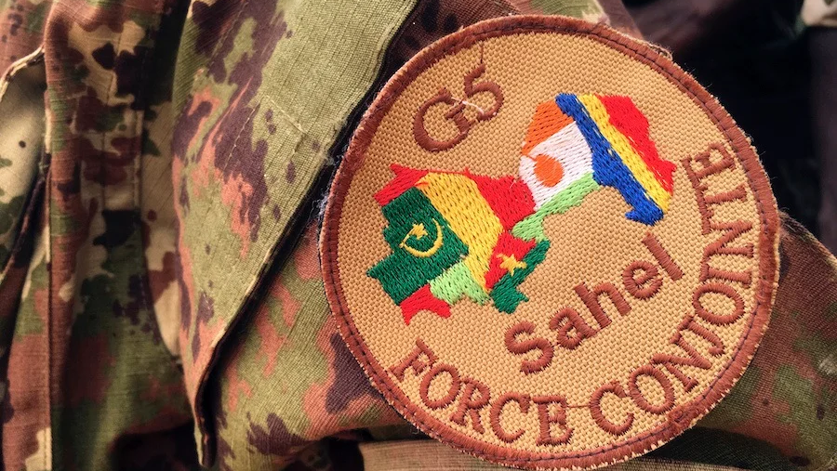
q&a
Any additional questions or comments from your side?

