Slide 1
The game-changing Normandy format
Hertie School of Governance “Trends of German Foreign Policy“ September 18, 2022

Slide 2
What is the game-changer?
For the first time, Germany (in its democratic form of government) has taken the lead on an imminent international security crisis
The U.S. has – for the first time since the end of WWII – deliberately decided to not engage itself in a full-fledged manner to deal with a security issue on the European continent
While having been a powerful Entente for a while, France and Germany now forcefully take the driver seat in a matter concerning the European security architecture as a whole
The Chancellery itself has taken the lead on a dossier that has traditionally been a matter of the Foreign Office and the Defense Ministry

Slide 3
Profound unsetting of the European security architecture (territorial integrity, political sovereignty, peaceful conflict settlement)
Historic turning point in EU-Russia relations
Prelude to conflict-ridden relationship in a variety of theatres (Syria, Libya, etc.)
Till date: 13.000 casualties, 2.2 million refugees (UNHCR)

Slide 4
A short overview: Actors I
SMM: In April 2014, the OSCE (including Russia) agrees to deploy a Special Monitoring Mission (SMM) to Ukraine. The SMM is an unarmed, civilian mission. Mandate: document political development and human rights record. Since September 2014: monitor the Donbas ceasefire.
TCG: The Trilateral Contact Group (Ukraine, Russia, separatists), under the coordination of the OSCE, convenes in June 2014.
Russian-American-Track: Informal meetings and talks between Assistant Secretary of State for Europe and Diplomatic Advisor to the President throughout 2015

Slide 5
A Short overview: Actors II
Normandy Format: Comprised of France, Germany, Russia und Ukraine. First at the level of heads of state of government, later on the levels foreign ministers, high officials and Foreign Policy Advisors

Slide 6
Minsk agreements I & II
Represent the most important outcome of the international peace effort to date.
Minsk I (September 2014):
→ Immediate ceasefire, monitored by the OSCE
Decentralization of Ukraine, including a special status law for the contested areas (language, culture, partial autonomy from central government)
Buffer zone along Russian-Ukrainian border
Release of all hostages and illegally detained persons
Ukraine amnesty law for all involved in the conflict
Continuation of a national dialogue
Withdrawal of illegal armed units from Ukrainian territory

Slide 7
Minsk agreements I & II
Minsk II became necessary due to insufficient progress of Minsk I in securing the ceasefire and implementing the agreement.
Kyiv agreed to disband Ukrainian militias
Kyiv agreed to resume social benefit and pension payments to recipients in contested areas
Kyiv agreed to draw up a strategy for economic reconstruction
Separatists agreed to disband their armed units and dissolve their emerging quasi-state structures
Separatists agreed to reintegration of the Donbass into the Ukrainian state
Important: Minsk Agreements do not treat Russia as a party to the conflict.

Slide 8
Steinmeier formula
Main points of contention: modalities for holding elections, status of the contested areas within the Ukrainian state and the timing for returning full control of the Russian border to Kyiv.
Kyiv: Impossible to keep our side of the deal if ceasefire is not permanent
Very important instrument in foreign policy: sequencing!
Method to overcome prisoner´s dilemma
Instead of forcing a full-fledged implementation all at once, step-by-step allows the growth of trust
Small steps can unlock bigger steps
Heads of State and Government met in October 2016 to formulate “road map” for implementing the Steinmeier Formula

Slide 9
Time passes by
Manifestation of status quo
Russia has ended out 200.000 passports to Ukrainian citizens
Ukraine cannot compete with Russian pensions
“Russification” of schools, culture and public life
“Donbass-fatigue” by growing number of Ukrainians
International attention has moved on
Growing impatience on the side of France and Germany (both with Kyiv and Moscow)

Slide 10
Major reasons for stalemate
Constellation of TCG and Normandy: Separatists are represented in TCG, but not in Normandy Format. Political issues are discussed in Normandy format, but Moscow insist on having the outcomes confirmed by the TCG
Thus, the Kremlin guards its decision-making autonomy while forcing the other actors to recognize separatists
Key Minsk provisions are deeply unpopular among Ukrainian population (especially special status law, amnesty law). Selensky would risk a great amount of political capital
Russia knows that France (especially) and Germany will face increasing difficulties to uphold the EU sanction regime vis-à-vis Russia

Slide 11
Reading exercise
German Power and the Ukraine Conflict by Ulrich Speck (Carnegie)
France, Germany and the “Russia Engagement” Game by Jonathan Eyal (Royal United Services Institute)
Please form three groups (5 – 5 – 4), divide the readings among the group, and discuss the following question:
Both authors bring forward arguments why Germany is particularly suited or unsuited to occupy a leadership role in the EU´s relation with Russia – particularly with regard to Ukraine. Please summarize their arguments, discuss them against the backdrop of Russa´s recent military campaign against Ukraine, and explain your own position (1 per group)
Time: 45 minutes

Slide 12
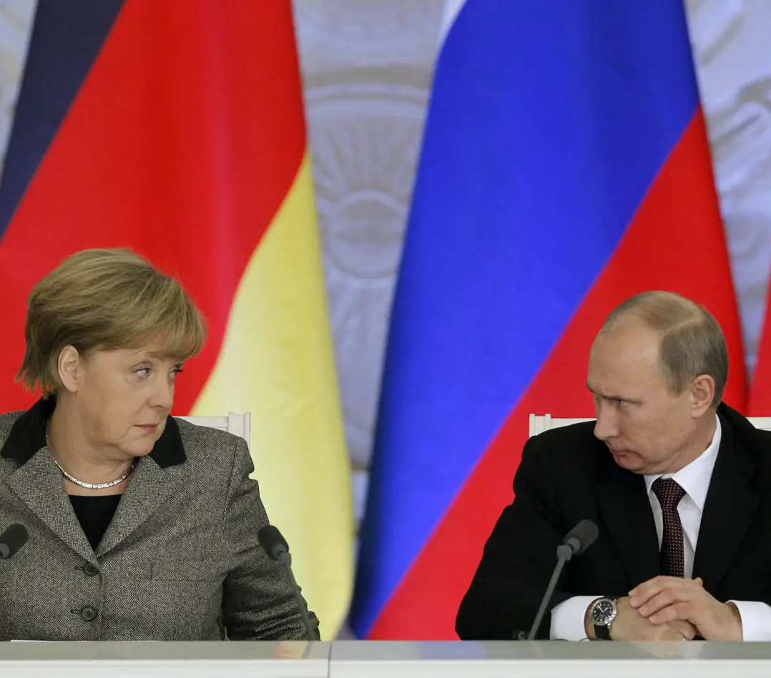
q&a
Any additional comments or questions from your side?

