Slide 1
Making foreign policy decisions
Hertie School of Governance “Trends of German Foreign Policy“ September 17, 2022

Slide 2
Executive
Legislative
Judiciary
NGOs
Media
Supranational Level
Citizenry
(Political) Science
Global Economy

Slide 3
Parliament I
Parliament is concerned with three aspects of the foreign policy process:
Shedding light on Government policy:
→ Hearings, plenary debates and resolutions
→ In extraordinary cases: Parliamentary Enquiry Committee
Mandating military deployment:
Exclusive right of parliament, as enshrined in the “Parlamentsbeteiligungsgesetz”
Article 24 Basic Law: „With a view to maintaining peace, the Federation may enter into a system of mutual collective security; in doing so it shall consent to such limitations upon its sovereign powers as will bring about and secure a lasting peace in Europe and among the nations of the world.
Budget approval (on a rolling basis)
Gateway for indirect policy-making by Parliament

Slide 4
Parliament iI
Parliamentary access is weak:
No access to intelligence reports (although oral intelligence briefings upon request)
No access to diplomatic cables (although oral briefings upon request)
No genuine law-making competence of the Standing Committees (Foreign Affairs; Defense; Economic Cooperation and Development; European Affairs)
On the upside: increasing number of field visits, parliamentary group exchange and visits by foreign dignitaries to Berlin

Slide 5
PARLIAMENT III
Parliamentary initiative and control is weak:
No law-making competence of the Standing Committees (Foreign Affairs; Defense; Economic Cooperation and Development; European Affairs)
Parliamentary resolutions are non-binding (“We call upon the government…”). Basis: Article 32 Basic Law: ”Relations with foreign states shall be conducted by the Federation.”
Mandates for military deployment abroad can only be adopted or rejected, but not amended (although informal processes de facto allow so)
No confirmation hearings for senior civilian and military personnel (experience from the “Weimar Republic”)

Slide 6
Parliament IV
Special Case I: Parliamentary Oversight Panel (PKGr)
Responsible for scrutiny of intelligence services at Federal level
Panel can demand the submission of detailed information by the Government (general activities and on operations of particular importance)
Composed of members from all parliamentary groups
(Very) Special Case II: G10-Commission
Takes decisions on the necessity and admissibility of restrictions on the privacy of correspondence, posts and telecommunications pursuant to Article 10 of the Basic Law.
Benchmark: „protection of the free democratic basic order or the existence of security of the Federation or of a Land)

Slide 7
Parliament V
Special Case III: Parliamentary Enquiry Committee
Article 44 Basic Law enshrines the parliamentary right to establish a special committee by which Parliament serves as both court and prosecutor. The code of criminal procedure applies.
Precondition: 25% of Parliament votes in favor of establishing an Enquiry Committee
Recent examples: NSA-BND Enquiry Committee; Air Strike in Kunduz in September 2009.

Slide 8
Parliament VI
Special Case IV: European Policy
Matters concerning the European Union must be broad to the attention of Parliament “comprehensively and to the earliest possible moment” (Article 23 Basic Law)
Parliament is invited to issue a statement on legal acts on the European level that shall be taken into account by the Government
Chancellor gives “Government Policy Statement” to Parliament immediately before European Council.

Slide 9
Government I
Principle I: ”Federführung” (lead management)
Very sensitive matter in every bureaucracy
Humanitarian aid vs. development aid; defense procurement vs. defense export; NATO as a security actor and NATO as a political actor
Conflicting interests: wanting to be in charge vs. being able to pass the buck when things go bad. Examples: Afghanistan withdrawal / extraction of local staff; German frigate port call to China
Critics: Prevents “whole-of-government” approach and fosters inter-agency encapsulation and silo mentality
Especially difficult if ministries are under the leadership of different parties

Slide 10
Government II
Principle II: “Richtlinienkompetenz”
Article 65 Basic Law: “The Federal Chancellor shall determine and be responsible for the general guidelines of policy.”
Although being enshrined in the Constitution, the “Richtlinienkompetenz” solely rests upon political legitimacy and the balance of power within the executive.
Chancellor Merkel preferred “silent Richtlinien-
kompetenz” (e.g. Nawalny case)

Slide 11
Government III
Principle III: “Ressortprinzip”
Article 65 Basic Law: “The Federal Chancellor shall determine and be responsible for the general guidelines of policy. Within these limits each Federal Minister shall conduct the affairs of his department independently and on his own responsibility.”
Two diverging trends:
Decentralization. The buck does not stop in the Chancellery. Question: Should the government headquarter really bear responsibility for intelligence oversight?
Centralization. A growing foreign policy spectrum is determined by the Chancellery (European affairs, transatlantic relations, Ukraine, for a while: Libya and Sahel, Western Balkans)

Slide 12
Bureaucracy Chain of command
Minister
State Secretary
Director-General
Group Leader
Unit Leader
Desk Officer
Strategic Level
Coordination level
Operational Level
Coordination Level
Policy Level
”Escalation Ladder”
Policy Level

Slide 14
Government IV
Foreign Office
Defense
Chancellery
Development and Economic Cooperation
The lead ministry formulates a draft policy decision
Lead management ministry decides on
who should be involved when and to what extent.
Accelerators: time constraints, work spirit, policy quality
If necessary: Issue is “escalated” up the ladder
“Loop of Reconcilement” until consensus has been found

Slide 15
Judiciary I
Supreme Court follows a dual-track approach:
Empowering the Legislative as the gatekeeper for military means
Providing the Executive with sufficient leeway to carry out its foreign policy objectives (Flick ruling 1984)
→ Supreme Court as “power broker” between Executive and Legislative
Increasing actorness and law diplomacy
Growing challenge: Progress of European integration while preserving the core of national sovereignty and thus statehood

Slide 16
Case Study: guidelines indo-pacific I
Foreign Office comes up with the idea that we need a strategy on the Indo-Pacific:
Strategic epicenter of the 21st century
Significant importance for international security (SCS, Taiwan, etc.)
Significant economic interests (Strait of Malacca, etc.)
Foreign Office forms an inner-ministerial working group to brainstorm ideas for a “White Book”:
Talks with NGOs, scholars and pundits
Talks with Parliament
Talks with strategic partners (EU, USA, Japan, etc.)
Parallel: Other Ministries inform their leadership

Slide 17
Case Study: guidelines indo-pacific II
Foreign Office presents a first draft to all concerned ministries
Complex ”formation of will” starts within the concerned ministries.
First round of feedback: usually up the ladder to “group leader” level
Foreign Office seeks to reconcile positions, offers compromise language, tries to defend its “core interests” (e.g. strong language on human rights)
Second round of formation of will within the concerned ministries, talks are ”kicked up the ladder”
…
After final compromise has been reached: Cabinet approves the “White Book”
Parliament comments the “White Book” in hearings and plenary debate

Slide 18
Review of status quo
Afghanistan withdrawal has fueled debate whether Germany´s foreign policy decision-making process is adequately suited to handle high-stakes, high-intensity challenges.
National Security Council?
Low level of influence by Parliament increasingly raises eye-brows. Should the desk officer have more influence on Germany´s role in the world than an elected representative?

Slide 19
Key findings I
I. Legislative:
Exclusive competence to mandate Bundeswehr operations abroad
Comparably tight control of budget, even after it has been formally passed
Comparably low control of both strategic decisions and day-to-day policy
II. Executive:
Enjoys great leeway in executing foreign policy
Extensive scope of „core area of executive self-responsibility“
III. Judiciary:
Serves as power broker
Increasing Actorness“(“Law Diplomacy“ )

Slide 20
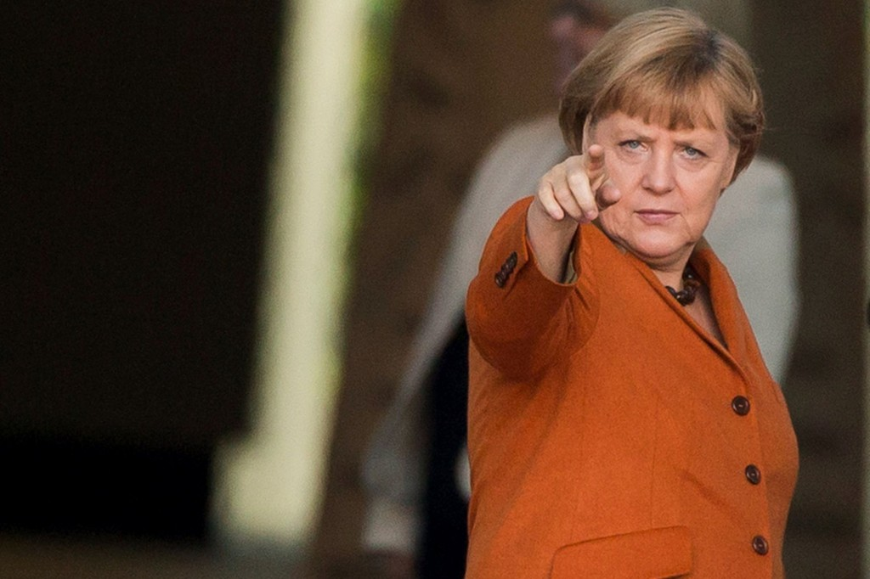
q&a
I am looking forward to any questions or comments that you may have.

